Slide 1


ONLINE VIDEO/AUDIO STREAMING SERVICE BASED ON DECENTRALIZED ARCHITECTURE
By
B150388568 Ishan Joshi
B150388586 Kishlaya Kunj
B150388597 Neeraj Lagwankar
Guide
Prof. Shamla Mantri

Slide 2
PROBLEM STATEMENT
To develop a progressive web application for blockchain based video and audio streaming services, inculcating the concept of peer-to-peer communication and decentralized framework.
Project Objective :
To develop a video and audio streaming service with minimum failure points.
To understand how blockchain works.

Slide 3
NEED
Lack of robustness
Security
Concurrent content delivery
Data monopolization by a central authority

Slide 4
INTRODUCTION
To address the shortcomings of the conventional internet architecture, we have undertaken this project to work on the same, specifically, in the domain of video and audio streaming.
By using the Ethereum platform, which implements blockchain, we secure the people’s private data accessed by malicious actors and by using InterPlanetary File System we were able provide video and audio content at lower latency and in real time.
Our platform is robust, secure and provides multimedia content at lower bandwidth seamlessly.

Slide 5





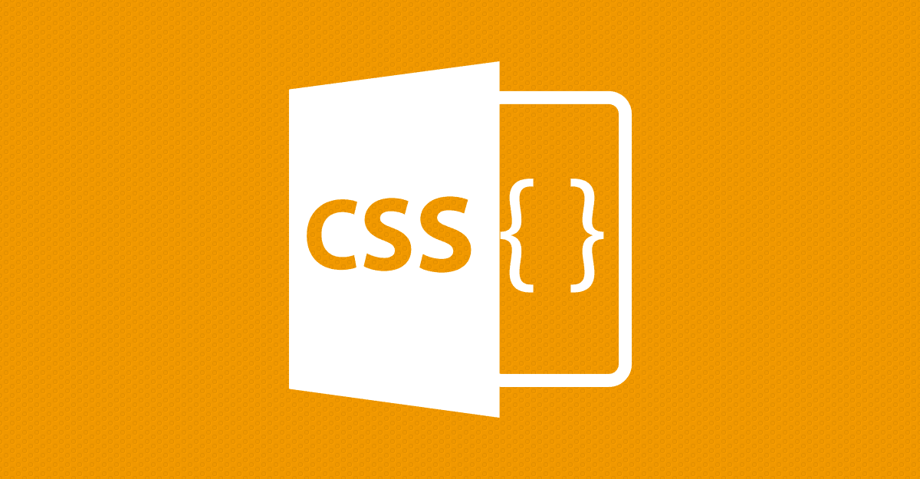
TECHNOLOGIES USED

Slide 6
COMPONENTS
Peer-to-peer file sharing
Distributed Hash Table
Blockchain
Consensus Protocol
Self-certifying File System
Smart Contracts

Slide 7
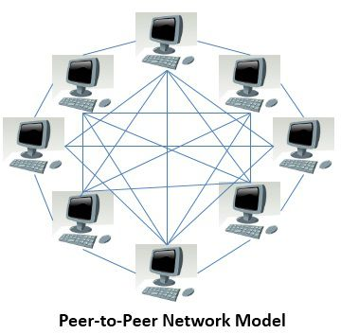
PEER TO PEER FILE SHARING
P2P file sharing leverages its users’ resources to distribute all types of digital files to its consumers without the need of a central governing model.
It is self-maintaining, resilient and only needs limited infrastructure and control. It is vastly superior, faster, more secure and robust than the existing client server architecture.

Slide 8

DISTRIBUTED HASH TABLES
Distributed Hash Tables are used as a lookup service in distributed and decentralized services.

Slide 9
BLOCKCHAIN
It is a growing database of records that has been executed among peers who have taken part in the transaction.
A node or a block contains a timestamp, a set of transactions, a nonce, hash of the current block and hash of its predecessor.

Slide 10
Consensus protocols are used to provide authenticity, non-repudiation and integrity to the blockchain network, by utilizing a decentralized peer-to-peer network for verification of transactions before adding a block to the public ledger.
CONSENSUS PROTOCOL
Proof of Work
Proof of Stake
Proof of Activity
Proof of Burn
Proof of Capacity
Proof of Elapsed Time

Slide 11
It provides one namespace for all the files in the world. It is inherently secure, and hence its users can share sensitive files without worrying about a third party tampering or reading the file.
SELF -CERTIFYING FILE SYSTEM
host ID = {PK_{s}, hostname}_{SHA-1}
session ID = {K_{cs}, K_{sc}, PK_{t}, N₀}_{SHA-1}
C S: hostname, host ID
S C: PK_{s}, PK_{t}, N₀
C S: {{K_{CS}, K_{SC}}_{PKt}}_{PKs}, session ID, N₀

Slide 12
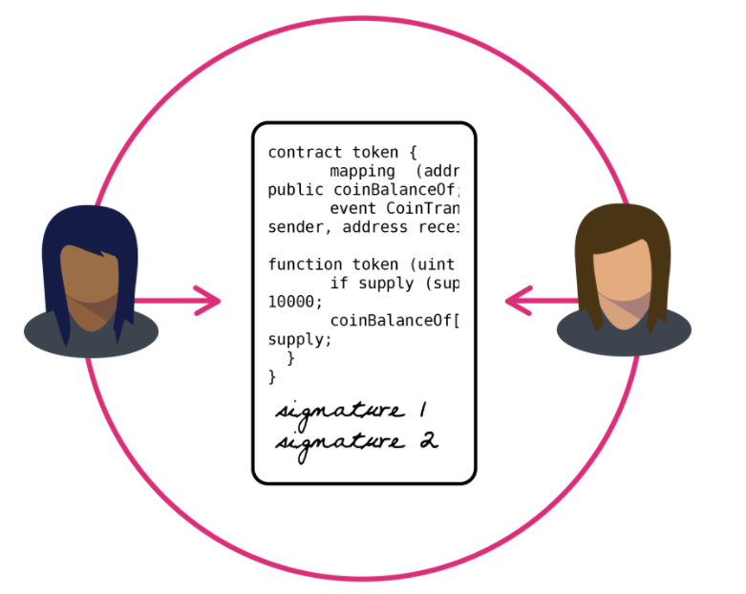
SMART CONTRACTS
It is a digital contract that is written in source code and executed by computers, which integrates the tamper-proof mechanism of blockchain.
Smart contracts use consensus protocols to agree upon the series of actions resulting from the contracts content.

Slide 13


BACKBONE OF OUR PLATFORM

Slide 14
ETHEREUM
Ethereum represents a blockchain with a built-in Turing complete programming language called Solidity.
It facilitates an abstract layer allowing anyone to create their own rules for ownership, formats of transactions, and state transaction functions.

Slide 15
IPFS
Its a peer-to-peer distributed file system.
The torrent protocol facilitates relocation of data between nodes comprising the infrastructure and the Kademlia Distributed Hash Table is used for the management of metadata.

Slide 16
DESIGN
Software design is the process by which an agent creates a specification of a software artifact, intended to accomplish goals, using a set of primitive components and subject to constraints.
Software design refers to all the activities involved in conceptualizing, framing, implementing, commissioning, and ultimately modifying complex systems.

Slide 17
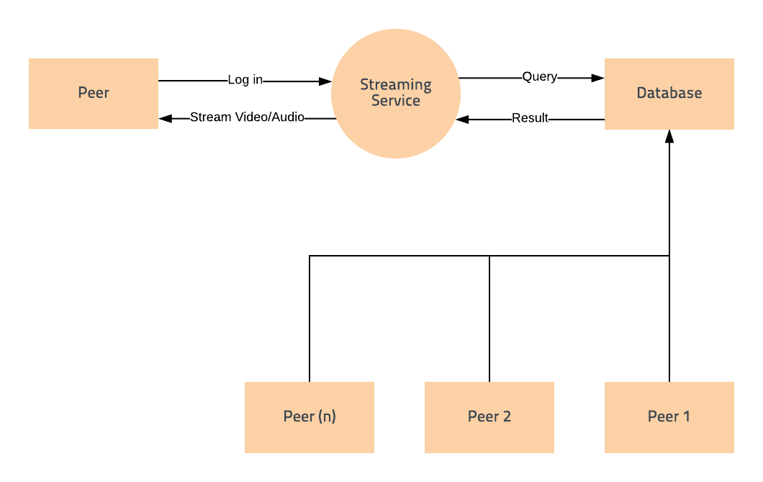
DATA FLOW DIAGRAM
A Data Flow Diagram is a way of representing a flow of a data of a process or a system. The DFD also provides information about the outputs and inputs of each entity and the process itself.
DFD Level 0:
A context diagram is a top level (also known as "Level 0") data flow diagram. It only contains one process node ("Process 0") that generalizes the function of the entire system in relationship to external entities.

Slide 18
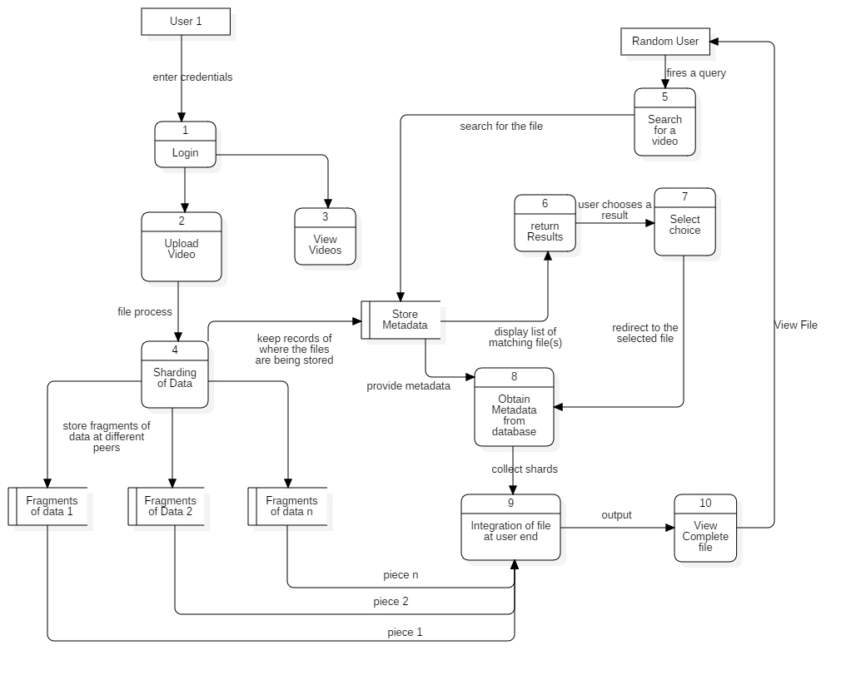
DFD Level 1:
The Level 1 DFD shows how the system is divided into sub-systems (processes), each of which deals with one or more of the data flows to or from an external agent, and which together provide all of the functionality of the system as a whole.

Slide 19
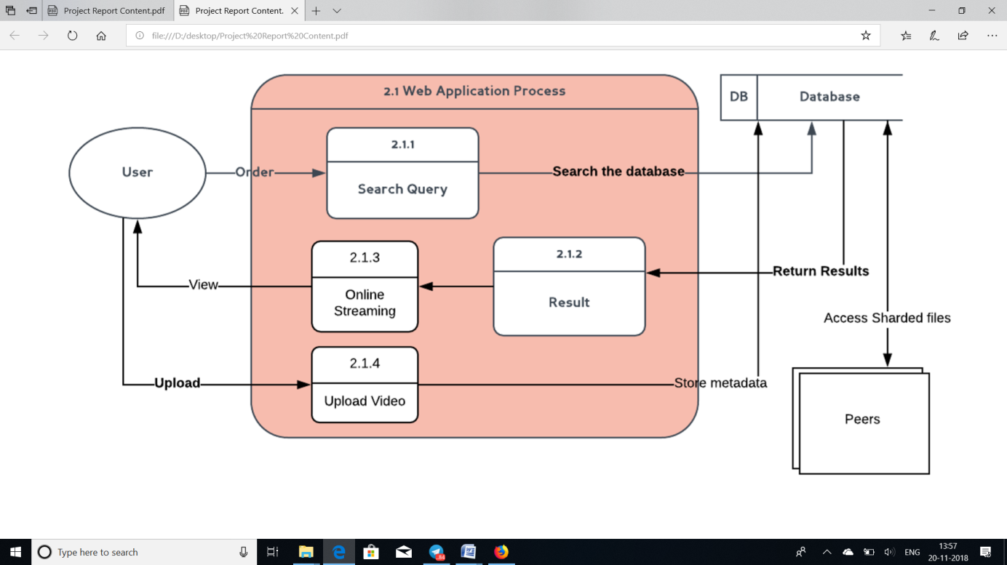
Level 2:
A level 2 data flow diagram (DFD) offers a more detailed look at the processes that make up an information system than a Level 1 DFD does. It can be used to plan or record the specific makeup of a system. You can then input the particulars of your own system.

Slide 20
Uml diagrams
A UML diagram is a diagram based on the UML (Unified Modeling Language) with the purpose of visually representing a system along with the purpose of visually representing a system along with its main actors, roles, actions, artifacts or classes, in order to better understand, alter, maintain, or document information about the system.

Slide 21
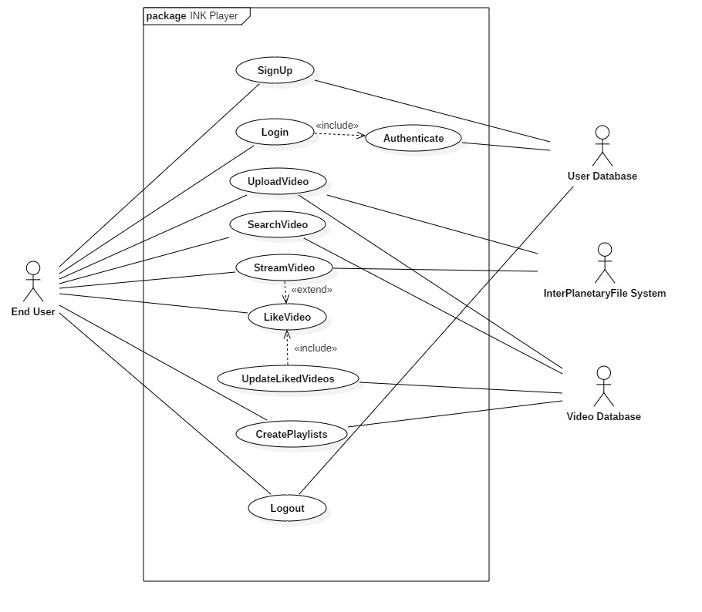
USE CASE DIAGRAM
Use case diagrams are usually referred to as behavior diagram used to describe a set of actions (use cases) that some system or systems (subject) should or can perform in collaboration with one or more external users of the system (actors).

Slide 22
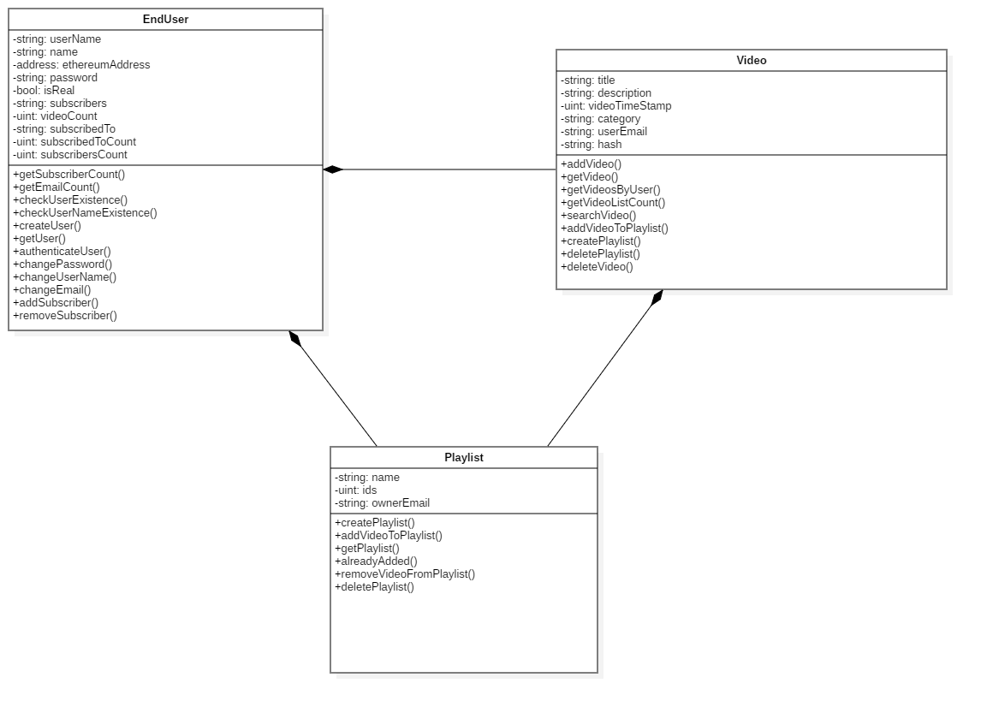
CLASS DIAGRAM
In software engineering, a class diagram in the Unified Modeling Language (UML) is a type of static structure diagram that describes the structure of a system by showing the system's classes, their attributes, operations (or methods), and the relationships among objects.

Slide 23
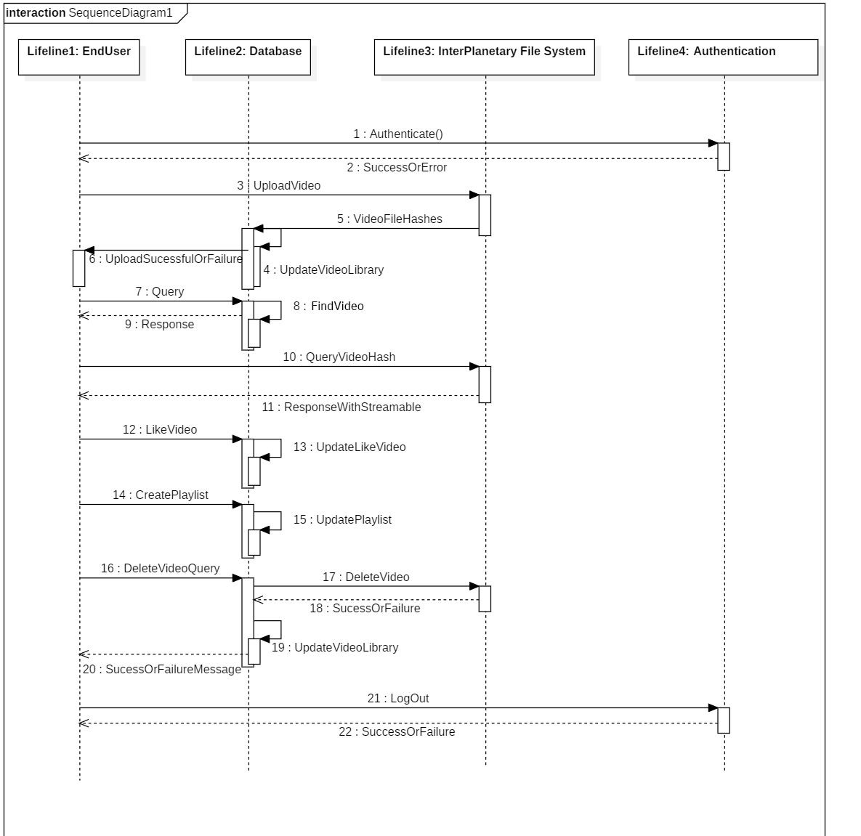
SEQUENCE DIAGRAM
Sequence diagrams are sometimes called event diagrams or event scenarios. A sequence diagram shows, as parallel vertical lines (lifelines), different processes or objects that live simultaneously, and, as horizontal arrows, the messages exchanged between them, in the order in which they occur.

Slide 24
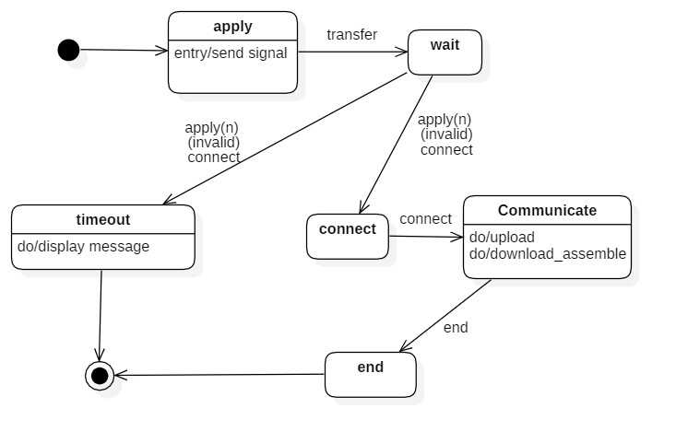
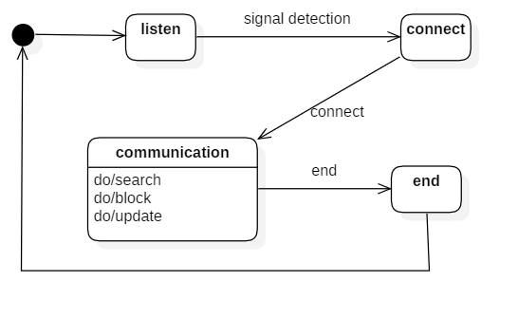
STATE CHART DIAGRAM
It's a behavioral diagram and it represents the behavior using finite state transitions. State diagrams are also referred to as State machines and State-charts.
State Chart Client Diagram
State Chart Server Diagram

Slide 25
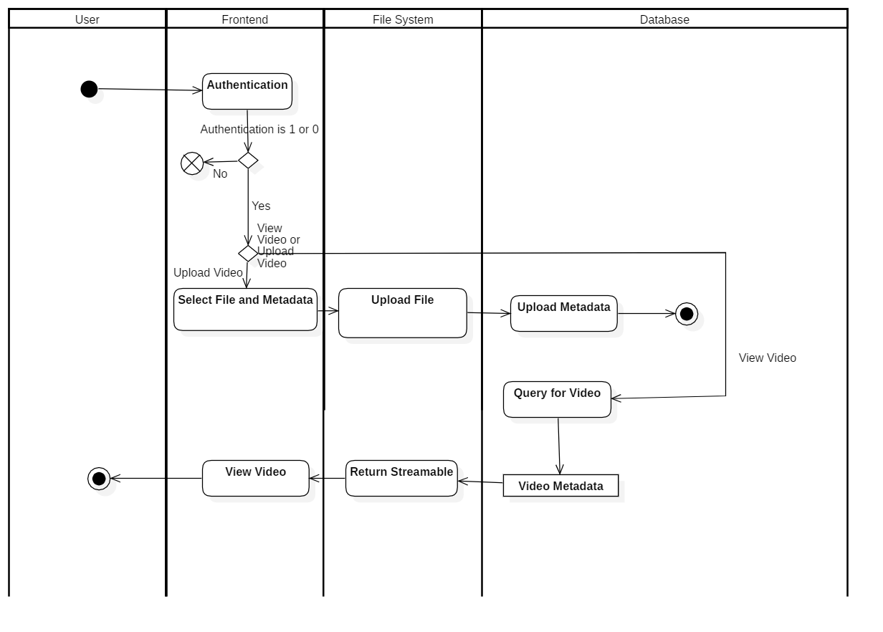
ACTIVITY DIAGRAM
Activity diagram is another important diagram in UML to describe the dynamic aspects of the system. Activity diagram is basically a flowchart to represent the flow from one activity to another activity. The activity can be described as an operation of the system. The control flow is drawn from one operation to another.

Slide 26
Project demonstration

Slide 27
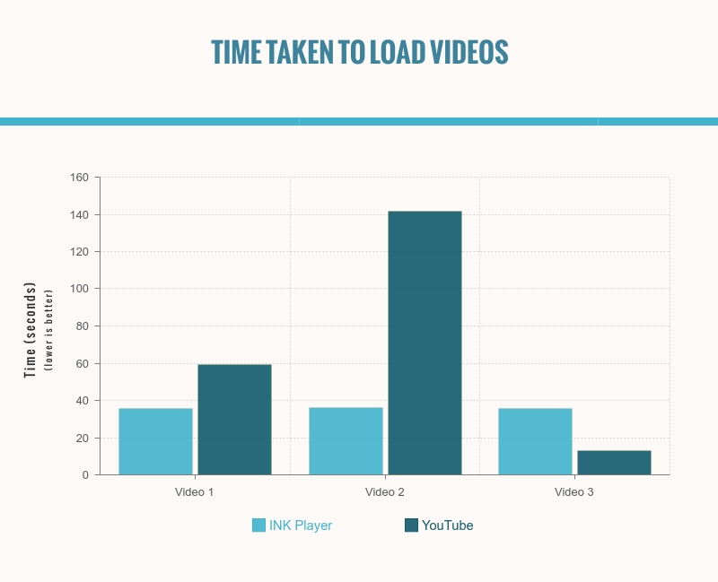
COMPARISON

Slide 28
REFERENCES
[1] Malik Muhammad Imran Pattal, Li Yuan, Zeng Jianqiu, ―Web 3.0: A real personal Web‖, IEEE, Third International Conference on Next Generation Mobile Applications, Services and Technologies, pp. 125128, 2009.
[2] Keshab Nath, Sourish Dhar, Subhash Basishtha, ―Web 1.0 to Web 3.0 - Evolution of the Web and its Various Challenges‖, IEEE, International Conference on Reliability, Optimization and Information Technology pp. 86 – 89, 2014.
[3] J. Blackburn, K. Christensen, ‖A Simulation Study of a New Green BitTorrent,‖ IEEE, Proc. Green Communications Workshop in conjunction with IEEE ICC’09, 2009.
[4] Olaf Landsiedel, Stefan Gotz, Klaus Wehrle, ―Towards Scalable Mobility in Distributed Hash Tables‖ IEEE, Peer-to-Peer Computing, 2006.
[5] Ling Zhong, Xiofan Wang, Maria Kihl, ―Topological Model and Analysis of the P2P BitTorrent Protocol‖, IEEE, Proceedings of the 8th World Congress on Intelligent Control and Automation, pp. 754758, 2011.
[6] Fabius Klemm, Sarunas Girdzijauskas, Jean-Yves Le Boudec, Karl Aberer, ―On Routing in Distributed Hash Tables‖, IEEE, 7th International Conference on Peer-to-Peer Computing, pp. 113-120, 2007.
[7] Lakshmi Siva Sankar, Sindhu M, M. Sethumadhavan, ―Survey of Consensus Protocols on Blockchain Applications‖, IEEE, International Conference on Advanced Computing and Communication Systems, 2017.
[8] Donhee Han, Hongjin Kim, Juwook Jang, ―Blockchain based Smart Door Lock System‖, IEEE, Information and Communication, pp. 1165, 2017.
[9] Jatinder Singh, John David Michels, ―Blockchain as a Service (Baas): Providers and Trust‖, IEEE, European Symposium on Security and Privacy Workshops, pp. 1165, 2018. [10] Deepak K. Tosh, Sachin Shetty, Xueping Liang, ―Consensus Protocols for Blockchain-based Data Provenance: Challenges and Opportunities‖, IEEE, 8th Annual Ubiquitous Computing, Electronics and Mobile Communication Conference (UEMCON), pages 469–474, 2017.
[11] Sachchidanand Singh, Nirmala Singh, ―Blockchain: Future of Financial and Cyber Security‖, IEEE, 2016 2nd International Conference on Contemporary Computing and Informatics (IC3I), pp. 463–467, 2016.
[12] Dejan Vujičić, Dijana Jagodić, Siniša Ranđić , ―Blockchain Technology, Bitcoin, and Ethereum: A Brief Overview‖, IEEE, 17th International Symposium INFOTEH-JAHORINA, 2018.

Slide 29
[13] Konstantinos Christidis, and, Michael Devetsikiotis, ―Blockchains and Smart Contracts for the Internet of Things‖, IEEE Access, Special Section on the Plethora of Research in Internet of Things, 2016.
[14] Sreehari P , M Nandakishore, Goutham Krishna, ―SMART WILL: Converting the Legal Testament into a Smart Contract‖, IEEE, International Conference on Networks & Advances in Computational Technologies, pp. 203-207, 2017.
[15] Satoshi Nakamoto, ―Bitcoin: A Peer-to-Peer Electronic Cash System‖, White Paper, 2008.
[16] David Mazieres, ―Self Certifying File System‖, Doctor of Philosophy, Massachusetts Institute of Technology, Massachusetts, USA, 2000.
[17] Juan Benet, ―IPFS - Content Addressed, Versioned, P2P File System (Draft 3)‖, White Paper, 2014.
[18] Jiin-Chiou Cheng, Narn-Yih Lee , Chien Chi , and Yi-Hua Chen, ―Blockchain and Smart Contract for Digital Certificate‖, IEEE, Proceedings of IEEE International Conference on Applied System Innovation, 2018.
[19] R. G. Shirey, K. M. Hopkinson, K. E. Stewart, ―Analysis of implementations to secure git for use as an encrypted distributed version control system", IEEE, 48th Hawaii International Conference on System Sciences, pp. 5310–5319, 2015.
[20] Ruchika Malhotra, Nakul Pritam, Kanishk Nagpal, "Defect Collection and Reporting System for Git based Open Source Software", IEEE, International Conference on Data Mining and Intelligent Computing (ICDMIC) 2014.
[21] HaeJun Lee, Bon-Keun Seo, Euiseong Seo, "A Git Source Repository Analysis Tool Based on a Novel Branch-oriented Approach", IEEE, International Conference on Information Science and Applications (ICISA), 2013.
[22] Nida Khan , Abdelkader Lahmadi , Jerome Francois and Radu State, ―Towards a Management Plane for Smart Contracts: Ethereum Case Study‖, IEEE, IFIP Network Operations and Management Symposium, 2018.

Slide 30
THANK YOU

